Slide 1
01/10/2021, 19:20
Cycle Sort - GeeksforGeeks
Related Articles
Save for later
Cycle Sort
Difficulty Level : Medium
Last Updated : 25 Mar, 2021
Cycle sort is an in-place sorting Algorithm, unstable sorting algorithm, a comparison sort that is theoretically optimal in terms of the total number of writes to the original array.
It is optimal in terms of number of memory writes. It minimizes the number of memory writes to sort (Each value is either written zero times, if it’s already in its correct position, or written one time to its correct position.)
It is based on the idea that array to be sorted can be divided into cycles. Cycles can be visualized as a graph. We have n nodes and an edge directed from node i to node j if the element at i-th index must be present at j-th index in the sorted array.
Cycle in arr[] = {2, 4, 5, 1, 3}
https://www.geeksforgeeks.org/cycle-sort/

Slide 2
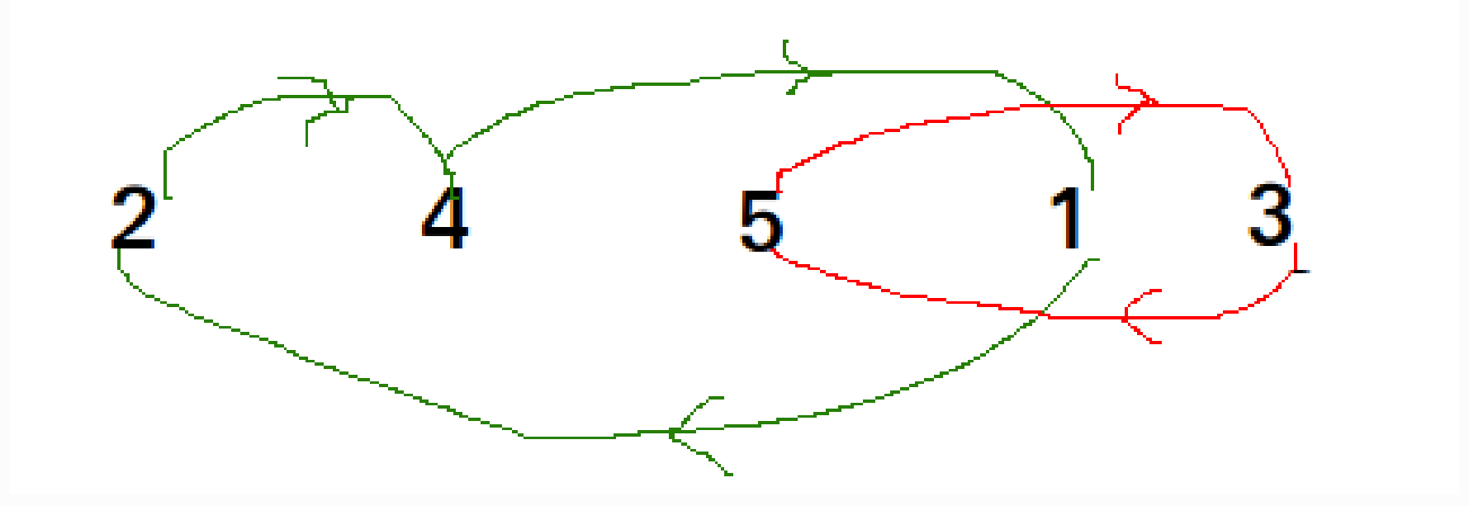
01/10/2021, 19:20
Cycle Sort - GeeksforGeeks
Cycle in arr[] = {4, 3, 2, 1}
https://www.geeksforgeeks.org/cycle-sort/

Slide 3
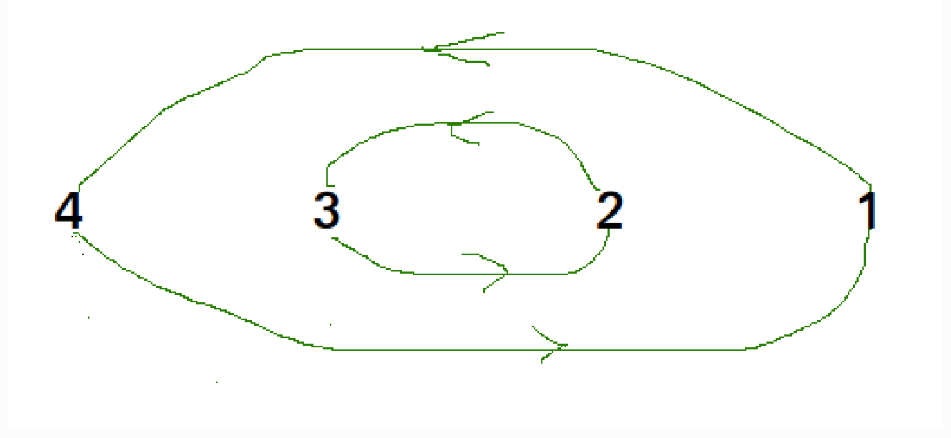
01/10/2021, 19:20
Cycle Sort - GeeksforGeeks
We one by one consider all cycles. We first consider the cycle that includes first element. We find correct position of first element, place it at its correct position, say j. We consider old value of arr[j] and find its correct position, we keep doing this till all elements of current cycle are placed at correct position, i.e., we don’t come back to cycle
starting point.
Recommended: Please try your approach on {IDE} first, before moving on to the solution.
Explanation :
https://www.geeksforgeeks.org/cycle-sort/

Slide 4
01/10/2021, 19:20
Cycle Sort - GeeksforGeeks
arr[] = {10, 5, 2, 3}
1 2
= 0
index = 0 cycle_start item = 10 =
3
arr[0]
Find position where pos = cycle_start i=pos+1
while(i<n)
if (arr[i] < item) pos++;
we put the item
We put 10 at old value of arr[] = {10,
item = 3
arr[3] arr[3].
and change item to
5, 2, 10}
Again rotate rest cycle that start with index '0'
Find position where we put the item = 3
we swap item arr[] = {10,
item = 5
with element at arr[1] now
3, 2, 10}
Again rotate rest cycle that start with index '0' and item = 5 we swap item with element at arr[2].
https://www.geeksforgeeks.org/cycle-sort/

Slide 5

01/10/2021, 19:20
arr[] = {10, 3, 5, 10 }
item = 2
Cycle Sort - GeeksforGeeks
Again arr[]
rotate rest cycle that start with
= {2, 3, 5, 10}
index '0' and item = 2
Above is one iteration for cycle_stat = 0. Repeat above steps for cycle_start = 1, 2, ..n-2
CPP
// C++ program to implement cycle sort #include <iostream>
using namespace std;
// Function sort the array using Cycle sort
void cycleSort(int arr[], int n)
{
// count number of memory writes
int writes = 0;
// traverse array elements and put it to on
// the right place
for (int cycle_start = 0; cycle_start <= n - 2; cycle_start++) {
// initialize item as starting point
int item = arr[cycle_start];
// Find position where we put the item. We basically
// count all smaller elements on right side of item.
int pos = cycle_start;
https://www.geeksforgeeks.org/cycle-sort/

Slide 6
01/10/2021, 19:20
Cycle Sort - GeeksforGeeks
for (int i = cycle_start + 1; i < n; i++)
if (arr[i] < item) pos++;
// If item is already in correct position
if (pos == cycle_start)
continue;
// ignore all duplicate elements
while (item == arr[pos]) pos += 1;
// put the item to it's right position
if (pos != cycle_start) { swap(item, arr[pos]); writes++;
}
// Rotate rest of the cycle
while (pos != cycle_start) { pos = cycle_start;
// Find position where we put the element
for (int i = cycle_start + 1; i < n; i++)
if (arr[i] < item) pos += 1;
// ignore all duplicate elements
while (item == arr[pos]) pos += 1;
// put the item to it's right position
if (item != arr[pos]) { swap(item, arr[pos]); writes++;
}
}
https://www.geeksforgeeks.org/cycle-sort/

Slide 7

01/10/2021, 19:20
Cycle Sort - GeeksforGeeks
}
// Number of memory writes or swaps
// cout << writes << endl ;
}
// Driver program to test above function
int main()
{
int arr[] = { 1, 8, 3, 9, 10, 10, 2, 4 };
int n = sizeof(arr) / sizeof(arr[0]); cycleSort(arr, n);
cout << "After sort : " << endl;
for (int i = 0; i < n; i++) cout << arr[i] << " ";
return 0;
}
Java
// Java program to implement cycle sort
import java.util.*;
import java.lang.*;
class GFG {
// Function sort the array using Cycle sort
public static void cycleSort(int arr[], int n)
{
// count number of memory writes
int writes = 0;
// traverse array elements and put it to on
// the right place
https://www.geeksforgeeks.org/cycle-sort/

Slide 8
01/10/2021, 19:20
Cycle Sort - GeeksforGeeks
for (int cycle_start = 0; cycle_start <= n - 2; cycle_start++) {
// initialize item as starting point
int item = arr[cycle_start];
// Find position where we put the item. We basically
// count all smaller elements on right side of item.
int pos = cycle_start;
for (int i = cycle_start + 1; i < n; i++)
if (arr[i] < item) pos++;
// If item is already in correct position
if (pos == cycle_start)
continue;
// ignore all duplicate elements
while (item == arr[pos]) pos += 1;
// put the item to it's right position
if (pos != cycle_start) {
int temp = item; item = arr[pos]; arr[pos] = temp; writes++;
}
// Rotate rest of the cycle
while (pos != cycle_start) { pos = cycle_start;
// Find position where we put the element
for (int i = cycle_start + 1; i < n; i++)
if (arr[i] < item) pos += 1;
// ignore all duplicate elements
https://www.geeksforgeeks.org/cycle-sort/

Slide 9
01/10/2021, 19:20
Cycle Sort - GeeksforGeeks
while (item == arr[pos]) pos += 1;
// put the item to it's right position
if (item != arr[pos]) { int temp = item; item = arr[pos]; arr[pos] = temp; writes++;
}
}
}
}
// Driver program to test above function
public static void main(String[] args)
{
int arr[] = { 1, 8, 3, 9, 10, 10, 2, 4 };
int n = arr.length; cycleSort(arr, n);
System.out.println("After sort : ");
for (int i = 0; i < n; i++) System.out.print(arr[i] + " ");
}
}
// Code Contributed by Mohit Gupta_OMG <(0_o)>
Python3
# Python program to implement cycle sort
def cycleSort(array): writes = 0
https://www.geeksforgeeks.org/cycle-sort/

Slide 10
01/10/2021, 19:20
Cycle Sort - GeeksforGeeks
# Loop through the array to find cycles to rotate.
for cycleStart in range(0, len(array) - 1): item = array[cycleStart]
# Find where to put the item. pos = cycleStart
for i in range(cycleStart + 1, len(array)):
if array[i] < item: pos += 1
# If the item is already there, this is not a cycle.
if pos == cycleStart:
continue
# Otherwise, put the item there or right after any duplicates.
while item == array[pos]: pos += 1
array[pos], item = item, array[pos] writes += 1
# Rotate the rest of the cycle.
while pos != cycleStart:
# Find where to put the item. pos = cycleStart
for i in range(cycleStart + 1, len(array)):
if array[i] < item: pos += 1
# Put the item there or right after any duplicates.
while item == array[pos]: pos += 1
array[pos], item = item, array[pos] writes += 1
return writes
https://www.geeksforgeeks.org/cycle-sort/

Slide 11

01/10/2021, 19:20
Cycle Sort - GeeksforGeeks
# driver code
arr = [1, 8, 3, 9, 10, 10, 2, 4 ]
n = len(arr) cycleSort(arr)
print("After sort : ")
for i in range(0, n) : print(arr[i], end = ' ')
# Code Contributed by Mohit Gupta_OMG <(0_o)>
C#
// C# program to implement cycle sort
using System;
class GFG {
// Function sort the array using Cycle sort
public static void cycleSort(int[] arr, int n)
{
// count number of memory writes
int writes = 0;
// traverse array elements and
// put it to on the right place
for (int cycle_start = 0; cycle_start <= n - 2; cycle_start++)
{
// initialize item as starting point
int item = arr[cycle_start];
// Find position where we put the item.
// We basically count all smaller elements
// on right side of item.
https://www.geeksforgeeks.org/cycle-sort/

Slide 12
01/10/2021, 19:20
Cycle Sort - GeeksforGeeks
int pos = cycle_start;
for (int i = cycle_start + 1; i < n; i++)
if (arr[i] < item) pos++;
// If item is already in correct position
if (pos == cycle_start)
continue;
// ignore all duplicate elements
while (item == arr[pos]) pos += 1;
// put the item to it's right position
if (pos != cycle_start) {
int temp = item; item = arr[pos]; arr[pos] = temp; writes++;
}
// Rotate rest of the cycle
while (pos != cycle_start) { pos = cycle_start;
// Find position where we put the element
for (int i = cycle_start + 1; i < n; i++)
if (arr[i] < item) pos += 1;
// ignore all duplicate elements
while (item == arr[pos]) pos += 1;
// put the item to it's right position
if (item != arr[pos]) {
int temp = item;
https://www.geeksforgeeks.org/cycle-sort/

Slide 13

01/10/2021, 19:20
item = arr[pos]; arr[pos] = temp; writes++;
}
}
}
}
// Driver program to test above function
public static void Main()
{
int[] arr = { 1, 8, 3, 9, 10, 10, 2, 4 };
int n = arr.Length;
// Function calling cycleSort(arr, n);
Console.Write("After sort : ");
for (int i = 0; i < n; i++) Console.Write(arr[i] + " ");
}
}
// This code is contributed by Nitin Mittal
Cycle Sort - GeeksforGeeks
Javascript
<script>
// Javascript program to implement cycle sort
// Function sort the array using Cycle sort
function cycleSort(arr, n)
{
// count number of memory writes
https://www.geeksforgeeks.org/cycle-sort/

Slide 14
01/10/2021, 19:20
Cycle Sort - GeeksforGeeks
let writes = 0;
// traverse array elements and put it to on
// the right place
for (let cycle_start = 0; cycle_start <= n - 2; cycle_start++)
{
// initialize item as starting point let item = arr[cycle_start];
// Find position where we put the item. We basically
// count all smaller elements on right side of item. let pos = cycle_start;
for (let i = cycle_start + 1; i < n; i++)
if (arr[i] < item) pos++;
// If item is already in correct position
if (pos == cycle_start)
continue;
// ignore all duplicate elements
while (item == arr[pos]) pos += 1;
// put the item to it's right position
if (pos != cycle_start)
{
let temp = item; item = arr[pos]; arr[pos] = temp; writes++;
}
// Rotate rest of the cycle
while (pos != cycle_start)
{
https://www.geeksforgeeks.org/cycle-sort/

Slide 15
01/10/2021, 19:20
Cycle Sort - GeeksforGeeks
pos = cycle_start;
// Find position where we put the element
for (let i = cycle_start + 1; i < n; i++)
if (arr[i] < item) pos += 1;
// ignore all duplicate elements
while (item == arr[pos]) pos += 1;
// put the item to it's right position
if (item != arr[pos]) { let temp = item; item = arr[pos]; arr[pos] = temp; writes++;
}
}
}
}
// Driver code
let arr = [ 1, 8, 3, 9, 10, 10, 2, 4 ];
let n = arr.length; cycleSort(arr, n);
document.write("After sort : " + "<br/>");
for (let i = 0; i < n; i++) document.write(arr[i] + " ");
// This code is contributed by susmitakundugoaldanga.
</script>
https://www.geeksforgeeks.org/cycle-sort/

Slide 16
01/10/2021, 19:20
Cycle Sort - GeeksforGeeks
Output:
After sort :
1 2 3 4 8 9 10 10
Time Complexity : O(n²) Worst Case : O(n²) Average Case: O(n²) Best Case : O(n²)
This sorting algorithm is best suited for situations where memory write or swap operations are costly.
https://www.geeksforgeeks.org/cycle-sort/

Slide 17
01/10/2021, 19:20
Cycle Sort - GeeksforGeeks
Cycle Sort | GeeksforGeeks
Reference:
https://en.wikipedia.org/wiki/Cycle_sort
This article is contributed by Nishant Singh. If you like GeeksforGeeks and would like to contribute, you can also write an article using contribute.geeksforgeeks.org or mail your article to contribute@geeksforgeeks.org. See your article appearing on the GeeksforGeeks main page and help other Geeks.
Please write comments if you find anything incorrect, or you want to share more information about the topic discussed above.
Attention reader! Don’t stop learning now. Get hold of all the important DSA concepts with the DSA Self Paced Course at a student-friendly price and become industry ready. To complete your preparation from learning a language to DS Algo and many more, please refer Complete Interview Preparation Course.
https://www.geeksforgeeks.org/cycle-sort/

Slide 18
01/10/2021, 19:20
Cycle Sort - GeeksforGeeks
In case you wish to attend live classes with experts, please refer DSA Live Classes for Working Professionals and Competitive Programming Live for Students.
Like
Previous
Next
Pigeonhole Sort
Cocktail Sort
ADVERTISEMENT BY ADRECOVER
https://www.geeksforgeeks.org/cycle-sort/

Slide 19
01/10/2021, 19:20
Cycle Sort - GeeksforGeeks
RECOMMENDED ARTICLES
Page :
1 2 3
01
Sort an Array which contain 1 to N values in O(N) using Cycle Sort
30, Apr 20
05
C++ Program for Cycle Sort
03, Feb 17
06
Comparison among Bubble Sort, Selection Sort and Insertion Sort
01, Apr 19
02
Java Program for Cycle Sort
03, Feb 17
03
07
Why Quick Sort preferred for Arrays and Merge Sort for Linked Lists?
16, May 15
Python Program for Cycle Sort
03, Feb 17
04
Detect cycle in Directed Graph using Topological Sort
31, Jul 20
08
Sort all even numbers in ascending order and then sort all odd numbers in descending order
11, Mar 17
https://www.geeksforgeeks.org/cycle-sort/

Slide 20

01/10/2021, 19:20
Cycle Sort - GeeksforGeeks
Article Contributed By :
Vote for di culty
Current di culty : Medium
GeeksforGeeks
Easy
Normal
Medium
Hard
Expert
Improved By :
nitin mittal,
rahul sholapurkar,
pedastrian,
susmitakundugoaldanga
Article Tags :
Sorting
Practice Tags :
Sorting
Report Issue
Writing code in comment? Please use ide.geeksforgeeks.org, generate link and share the link here.
Load Comments
ADVERTISEMENT BY ADRECOVER
https://www.geeksforgeeks.org/cycle-sort/

Slide 21
01/10/2021, 19:20
Cycle Sort - GeeksforGeeks
5th Floor, A-118,
Sector-136, Noida, Uttar Pradesh - 201305
feedback@geeksforgeeks.org
Company | Learn | Web Development | Contribute
About Us | Algorithms | Web Tutorials | Write an Article
Careers | Data Structures | HTML | Write Interview Experience
Privacy Policy | Languages | CSS | Internships
Contact Us | CS Subjects | JavaScript | Videos
Copyright Policy | Video Tutorials | Bootstrap
@geeksforgeeks , Some rights reserved
https://www.geeksforgeeks.org/cycle-sort/

